Slide 1


Carlos Moore
8/2/2024

Slide 2

Outline
Executive Summary
Introduction
Methodology
Results
Conclusion
Appendix
2
Notes:
2

Slide 3
Executive Summary
Summary of methodologies
Tables were constructed via web scraping Wikipedia and API calls to the Space-X API.
Data wrangling was employed to deal with null values, inappropriate data types, and missing attributes.
Performed EDA in SQL and visualization in MatPlotLib and Seaborn
Summary of all results
Produced several models to predict Falcon 9 stage 1 successful landings
Logistic Regression & Support Vector Machines yielded the best F-1 score for out-of-sample testing
3

Slide 4
Introduction
Project background and context
Space-X advertises Falcon 9 rocket launches on its website with a cost of 62 million dollars. Other providers cost upward of 165 million dollars each. Much of the savings is because Space-X can reuse the first stage.
Problems you want to find answers
If we can predict successful landings for first stage components, we can better determine the cost of each launch. Armed with this information, competitors could out bid Space-X for future launches.
4

Slide 5

Section 1
5

Slide 6
Methodology
Executive Summary
Data collection methodology:
Made get requests to Space-X API to collect several attributes of Space-X launches from 2006 to 2022 including: the mass of payloads, orbits achieved, boosters used, and launch sites.
Scraped the Wikipedia page on Space-X launches and extracted to Beautiful Soup object to construct a csv for later analysis.
Perform data wrangling
Records were restricted to only Falcon 9 launches.
Replaced or removed missing values and established a target.
Chose appropriate data types.
Perform exploratory data analysis (EDA) using visualization and SQL
Perform interactive visual analytics using Folium and Plotly Dash
Perform predictive analysis using classification models
Models evaluated: Decision Tree, K-Nearest Neighbor, Support Vector Machine, Logistic Regression
6
Notes:
6

Slide 7
Data Collection
Data was collected by first making a get request to the Space-X API to retrieve a JSON for all past launches; then read into a data frame.
Relevant features were chosen and records were restricted to a maximum date of 2020-11-13.
Records of rockets with multiple cores and payloads were also removed.
Using several pre-defined functions, data about individual launches was extracted to multiple lists for future use.
These lists were used to create a new frame for launch data; where all but Falcon 9 boosters were removed.
Finally, null values for payload mass were replaced by the attribute mean value.
7

Slide 8
Data Collection – SpaceX API
API Call: Data Acquisition
Normalize Response
API Call: Data Acquisition
Predefined functions use ID keys to make get requests for more data
Parse Data
Objective: Obtain data on Space-X launches
Formatting: JSON response converted to DataFrame
Feature Selection: rocket, payloads, launchpad, cores, flight_number, date_utc
Responses are extracted into a new DataFrame for launch data
Data Acquired: Details of launches and ID keys for rockets, payloads, launch pads, and cores
API Endpoint: Utilized Space-X API to fetch data
Data Handling: Data loaded and normalized for analysis
Data Cleaning:
Removed rows of launches with multiple cores and payloads
Restrict data to launches occurring before November 13th 2020
Launch data is filtered for only Falcon 9 rocket launches
Null values for payload mass are replaced with the payload mass average
Space-X Data Collection API Lab
https://github.com/Dichotmy/IBM-Data-Science-Professional/blob/main/10.%20Applied%20Data%20Science%20Capstone/Labs/1.%20SpaceX%20Data%20Collection%20API%20Lab.ipynb
8

Slide 9
Data Collection - Scraping
Static Request
Send request to Wikipedia page on Falcon 9 rocket launches
Extract Data
Extract all column names from the HTML table header
Parse Tables
Create empty dictionary using column headers as keys
Loop through soup object for data to append to dictionary
Normalize
Formatting: dictionary converted to DataFrame
Transfer contents of response to Beautiful Soup object
Names Discovered: 'Flight No.', 'Date and time ( )', 'Launch site', 'Payload', 'Payload mass', 'Orbit', 'Customer', 'Launch outcome'
Data Handling: Data loaded into csv for storage
Web Scraping Wikipedia for Space-X Launches
https://github.com/Dichotmy/IBM-Data-Science-Professional/blob/main/10.%20Applied%20Data%20Science%20Capstone/Labs/2.%20Web%20Scraping%20Wikipedia%20for%20SpaceX%20Launches.ipynb
9

Slide 10
Data Wrangling
Data Cleaning and Handling Missing Values
Data Types and Conversion
Feature Exploration
Creating New Feature: Class
Identified missing values:
Significant missing values in LandingPad column (28.89%)
No missing values in other columns
Actions taken:
Analysis considered missing LandingPad values as part of the exploration
Overview of data types:
Integers 3
Objects 7
Floats 4
Boolean 3
Ensured appropriate data types for analysis
Launch Sites:
Most frequent: CCAFS SLC 40 (55 launches)
Orbits:
Majority type: LEO (55 occurrences)
Landing Outcomes:
Categories include successful and unsuccessful landings
Derived feature Class based on landing outcomes:
Positive outcome (1) for successful landings
Negative outcome (0) for failed or no landings
Calculated success rate: 66.67%
10
https://github.com/Dichotmy/IBM-Data-Science-Professional/blob/main/10.%20Applied%20Data%20Science%20Capstone/Labs/3.%20Spacex%20-%20Data%20Wrangling.ipynb

Slide 11
EDA with Data Visualization
Visualized the relationship between several features of the Falcon 9 launch data set:
Cat plot of Payload Mass vs Flight Number differentiated by Class
Shows greater payloads attempted in latter flights
Cat plot of Launch Site vs Flight Number differentiated by Class
Shows gaps in launch site usage
Scatter Plot of Launch Site vs Payload Mass differentiated by Class
Vandenberg Air Force Base has the least launches
Cape Canaveral Air Force Station used mostly for low to mid-range payloads
Bar Plot showing the success rate of rocket landings by orbit location
Orbits for launches achieving a 100% success rate: ES-L1, SSO, HEO, GEO
Scatter Plot of Orbit vs Flight Number differentiated by Class
Scatter Plot of Orbit vs Payload Mass
Line plot revealing the success rate of launches by year
Steady increase in successful landings with a drop in 2018
11
https://github.com/Dichotmy/IBM-Data-Science-Professional/blob/main/10.%20Applied%20Data%20Science%20Capstone/Labs/5.%20EDA%20with%20Visualization%20Lab.ipynb

Slide 12
EDA with SQL
Performed data analysis through Jupyter Notebook on SQL-Lite database:
Loaded launch data set acquired through previous steps to SQL-Lite database
Displayed the names of distinct Falcon 9 launch sites
Displayed 5 records where launch sites begin with the string ‘CCA’
Displayed total mass of payloads carried for customer NASA(CRS)
45596 KG
Displayed average payload mass carried by booster version F9 v1.1
2928.4 KG
Date of first successful landing outcome on a ground pad
December 22nd 2015
Show boosters with successful landings on drone ships with a payload mass between 4000 & 6000 KG
Provide total counts for all mission outcomes
Provide list of all booster versions that have carried the maximum payload mass
Show the months, booster versions, and sites of launches with a failure to land on a drone ship in 2015
Rank the count of landing outcomes occurring between June 4th 2010 & March 20th 2017
12
https://github.com/Dichotmy/IBM-Data-Science-Professional/blob/main/10.%20Applied%20Data%20Science%20Capstone/Labs/4.%20Complete%20the%20EDA%20with%20SQL.ipynb

Slide 13
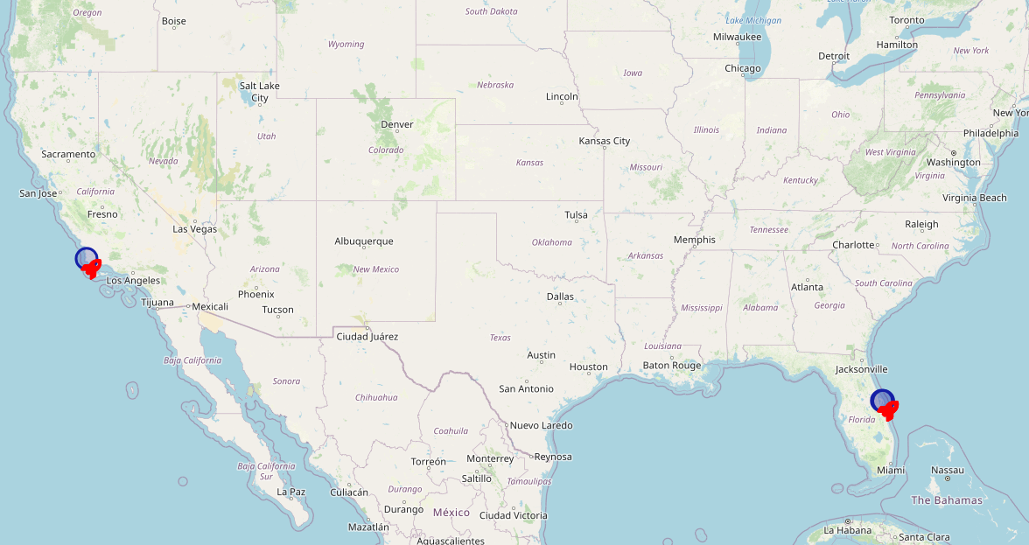
Build an Interactive Map with Folium
Created map markers to display launch site area as well as specific locations
13
https://github.com/Dichotmy/IBM-Data-Science-Professional/blob/main/10.%20Applied%20Data%20Science%20Capstone/Labs/6.%20Interactive%20Visual%20Analytics%20with%20Folium%20lab.ipynb

Slide 14
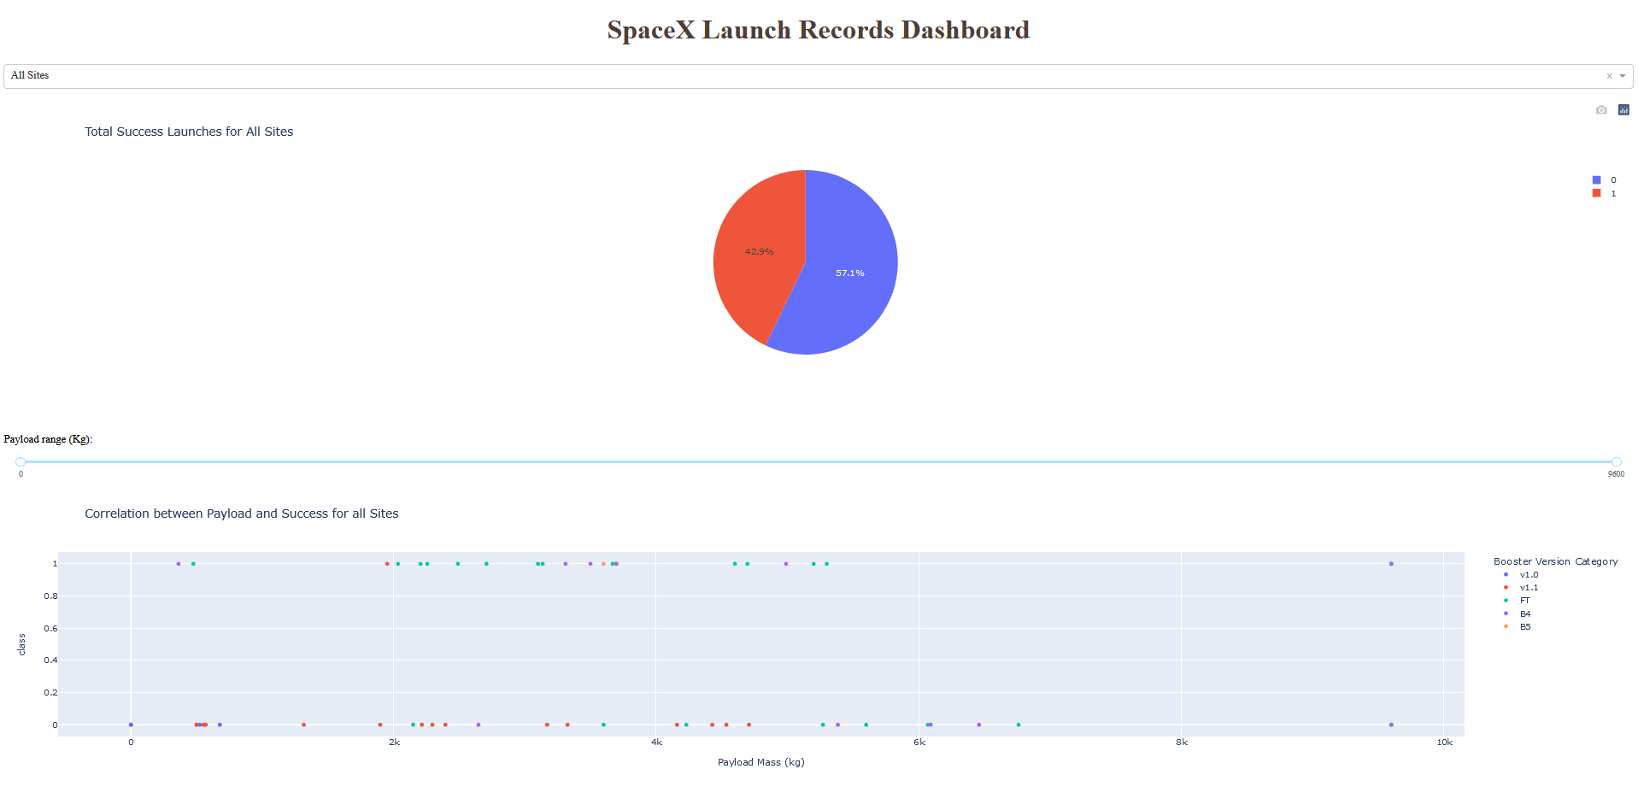
Build a Dashboard with Plotly Dash
Plots to show the success ratio of rocket landings by launch site and the correlation between class and outcome differentiated by booster version
14
https://github.com/Dichotmy/IBM-Data-Science-Professional/blob/main/10.%20Applied%20Data%20Science%20Capstone/Labs/7.%20Build%20a%20Dashboard%20Application%20with%20Plotly%20Dash.ipynb

Slide 15
Predictive Analysis (Classification)
Data Collection and Preparation
Data Preprocessing
Convert Target to NumPy Array
Apply StandardScaler() to standardize the features.
Data Splitting
Split the data into training and testing sets.
Stratify the data to ensure class proportionality amongst training and testing sets
Model Validation
Independent Model Tuning
Perform Grid Search for each model independently.
Evaluation Metric: Use accuracy to evaluate model performance.
Models Considered:
Decision Tree, K-Nearest Neighbors, Support Vector Machine, Logistic Regression
Model Evaluation
Training & testing accuracy for best model:
LG: 0.85, 0.833 SVM: 0.864, 0.833
DT: 0.918, 0.778 KNN: 0.864, 0.778
Conduct a second concurrent round of Grid Search using F1 score as the evaluation metric for the best models.
Load data from CSVs:
Target Analysis:
Features: (‘launch data’)
Target: ('Class')
Assess distribution: value_counts()
Observation: Class imbalance favoring successful landings by 2 to 1
Transform Features: fit_transform method used to scale training data.
Parameters used:
test_size = 0.2
random_state = 2
Training F1 score:
DT: 0.932 KNN: 0.906
SVM: 0.9 LG: 0.898
Testing: F1, Accuracy, and ROC-AUC:
DT: 0.80, 0.61, 0.60 KNN: 0.83, 0.78, 0.72
SVM: 0.89, 0.83, 0.75 LG: 0.89, 0.83, 0.71
Evaluation:
Discrepancies in F1 scoring between training and testing for models Decision Tree and KNN suggest over ‘overfitting’.
Selection:
With a good balance between training and testing performance, the Support Vector Machine appears to be the best model.
15
https://github.com/Dichotmy/IBM-Data-Science-Professional/blob/main/10.%20Applied%20Data%20Science%20Capstone/Labs/8.%20SpaceX%20Machine%20Learning%20Prediction.ipynb

Slide 16
Results
Exploratory Data Analysis reveal a few insights:
Launch Data shows a steady increase in successful landings with a drop in 2018.
As confidence in their technology grew Space-X began equipping rockets with heavier payloads.
All launches achieving the following orbits had a 100% landing success rate and carried light to medium payloads: ES-L1, SSO, HEO, GEO.
Cape Canaveral Air Force Station saw the highest number of rocket launches.
Results of Supervised Machine Learning:
During independent model evaluation accuracy scores for Logistic Regression and Support Vector Machines showed little difference between training and testing; however Decision Tree and K-Nearest Neighbor dropped by 16.5 & 10.5 percent respectively.
F1 scoring was used in the training portion of concurrent model evaluation and also for testing along with accuracy and ROC-AUC.
F1 scoring for SVM and LG models remained virtually identical at approximately 0.9 while DT model performance dropped significantly with a value of 15.3 percent.
With an F1 score of 0.89, an accuracy of 0.83, and an ROC-AUC of 0.75 the Support Vector Classifier implementing a sigmoid kernel and a gamma of 0.316 was chosen as the best model.
16
Notes:
16

Slide 17

Section 2

Slide 18
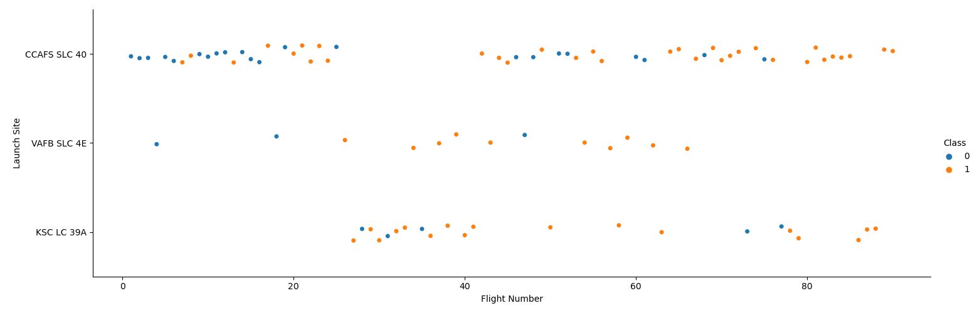
Flight Number vs. Launch Site
Scatter plot segmentation of Launch Site vs Flight Number differentiated by Class:
Shows gaps in usage for all three sites
Cape Canaveral Air Force Station has highest number of launches
18

Slide 19
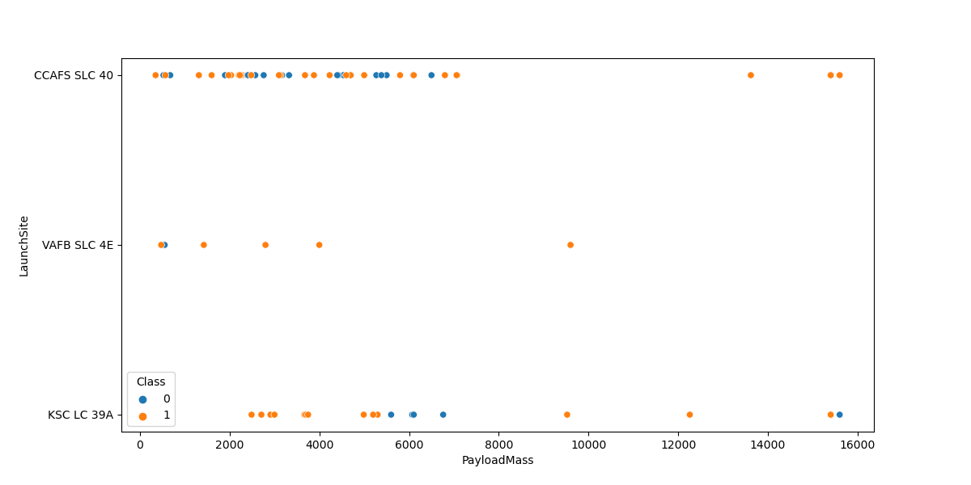
Payload vs. Launch Site
Scatter plot segmentation of Launch Site vs Payload Mass differentiated by Class:
Rockets launched from Kennedy Space Center carry a more even distribution of payload masses
Vandenberg Air Force Base and Cape Canaveral Space Station launch rockets carrying mostly low to mid-level payload masses
19

Slide 20
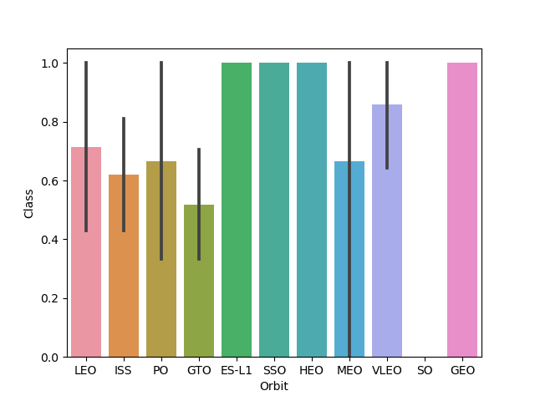
Success Rate vs. Orbit Type
Bar Chart measuring the success rate of rocket landings by type of orbit achieved during launch
Orbits with 100 % Success:
Earth-Sun Lagrange Point 1
Sun-Synchronous Orbit
Highly Elliptical Orbit
Geostationary Earth Orbit
20

Slide 21
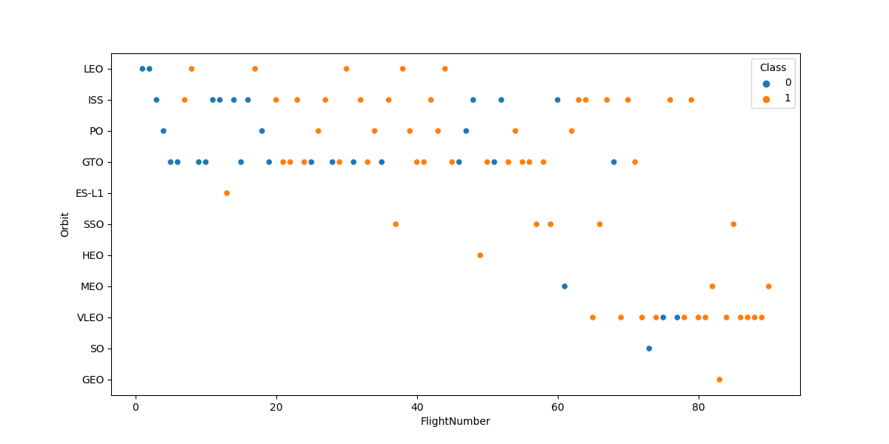
Flight Number vs. Orbit Type
Scatter plot of Orbit types achieved after launch vs Flight Number:
Orbits ES-L1, HEO, and GEO only have a single launch
Launches targeting the orbits of MEO, VLEO, SO, and GEO occur later in the flight record
21

Slide 22
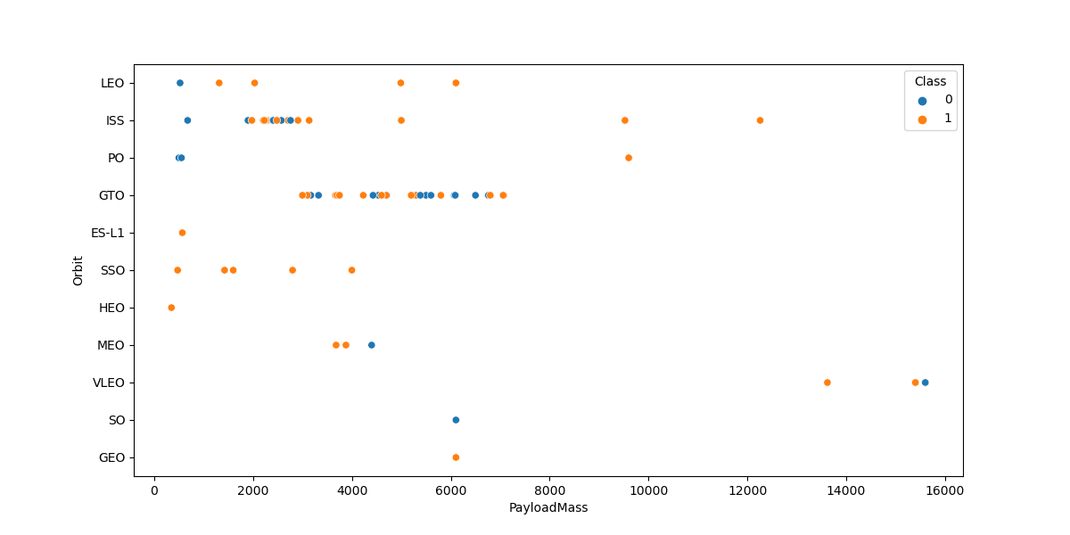
Payload vs. Orbit Type
Scatter plot of Orbit types achieved after launch vs Payload Mass:
Most orbits were achieved by rockets carrying low to medium payload masses
Rockets for the VLEO orbit carried large payloads
22

Slide 23
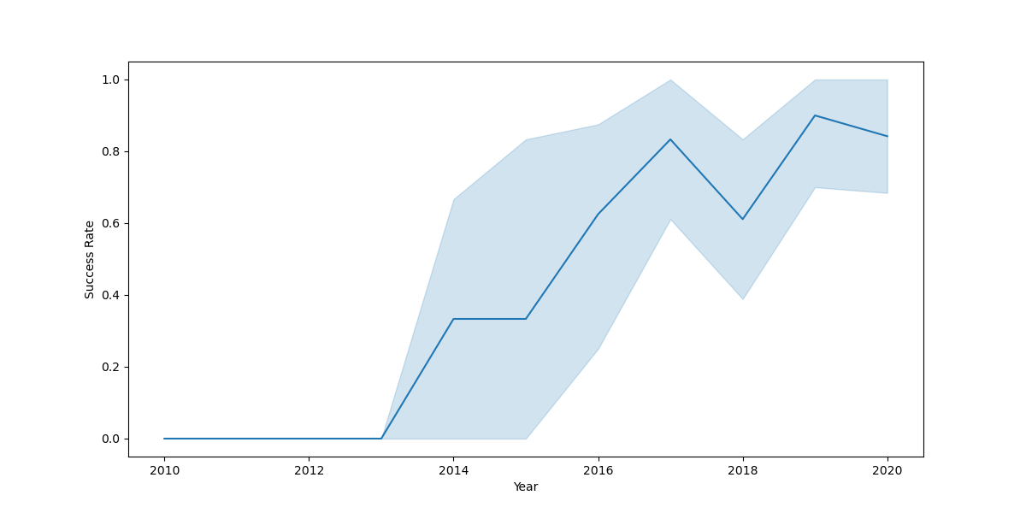
Launch Success Yearly Trend
Line plot of successful landing rate vs Year:
Plot shows no successful landings from 2010 to 2013
There is a steady step-wise increase in successful landings until 2017
2018 shows a drop in the success rate leading to another increase for 2019
23

Slide 24
All Launch Site Names
Unique Launch Sites:
CCAFS LC – 40
VAFB SLC – 4E
KSC LC – 39A
CCAFS SLC - 40
Queried the SQL-Lite database with the following command:
%sql select distinct Launch_Site as `Launch Sites` from SPACEXTABLE
24

Slide 25
Launch Site Names Begin with 'CCA'
The first 5 records where launch sites begin with `CCA`:
Date Time (UTC) Booster_Version Launch_Site Payload PAYLOAD_MASS__KG_ Orbit Customer Mission_Outcome Landing_Outcome
2010-06-04 18:45:00 F9 v1.0 B0003 CCAFS LC-40 Dragon… 0 LEO SpaceX Success Failure (parachute)
2010-12-08 15:43:00 F9 v1.0 B0004 CCAFS LC-40 Dragon demo… 0 LEO (ISS) NASA (COTS)… Success Failure (parachute)
2012-05-22 7:44:00 F9 v1.0 B0005 CCAFS LC-40 Dragon demo… 525 LEO (ISS) NASA (COTS) Success No attempt
2012-10-08 0:35:00 F9 v1.0 B0006 CCAFS LC-40 SpaceX CRS-1 500 LEO (ISS) NASA (CRS) Success No attempt
2013-03-01 15:10:00 F9 v1.0 B0007 CCAFS LC-40 SpaceX CRS-2 677 LEO (ISS) NASA (CRS) Success No attempt
Queried the SQL-Lite database with the following command:
%sql select * from SPACEXTABLE where Launch_Site like 'CCA%' Limit 5
25

Slide 26
Total Payload Mass
Total payload mass carried by boosters from NASA (CRS):
45596 KG
Queried the SQL-Lite database with the following command:
%sql select sum(PAYLOAD_MASS__KG_) as `Total Payload Mass for NASA (CRS)` from SPACEXTABLE where Customer == 'NASA (CRS)'
26

Slide 27
Average Payload Mass by F9 v1.1
Average payload mass carried by booster version F9 v1.1:
2928.4 KG
Queried the SQL-Lite database with the following command:
%sql select avg(PAYLOAD_MASS__KG_) as `AVG_MASS (F9 v1.1)` from SPACEXTABLE where Booster_Version == 'F9 v1.1'
27

Slide 28
First Successful Ground Landing Date
Dates of the first successful landing outcome on ground pad:
2015-12-22
Queried the SQL-Lite database with the following command:
%%sqlselect Date from SPACEXTABLE where lower(Landing_Outcome) like '%success%ground%‘ order by Datelimit 1
28

Slide 29
Successful Drone Ship Landing with Payload between 4000 and 6000 KG
Names of boosters which have successfully landed on a drone ship and had a payload mass between 4000 & 6000 KG:
F9 FT B1022
F9 FT B1026
F9 FT B1021.2
F9 FT B1031.2
Queried the SQL-Lite database with the following command:
%%sqlselect Booster_Versionfrom SPACEXTABLE where lower(Landing_Outcome) like '%success%drone%' and PAYLOAD_MASS__KG_ > 4000 and PAYLOAD_MASS__KG_ < 6000
29

Slide 30
Total Number of Successful and Failure Mission Outcomes
Queried the SQL-Lite database with the following command:
%sql select Mission_Outcome, count(*) from SPACEXTABLE group by Mission_Outcome
Returned:
Mission_Outcome count(*)
Failure (in flight) 1
Success 98
Success 1
Success (payload status unclear) 1
Updated table with the following query to amend error:
%%sql UPDATE SPACEXTABLE SET Mission_Outcome = 'Success‘ WHERE Mission_Outcome == 'Success '
30

Slide 31
Boosters Carried Maximum Payload
Names of boosters which have carried the maximum payload mass:
Booster_Version
F9 B5 B1048.4 F9 B5 B1049.4 F9 B5 B1051.3
F9 B5 B1056.4 F9 B5 B1048.5 F9 B5 B1051.4
F9 B5 B1049.5 F9 B5 B1060.2 F9 B5 B1058.3
F9 B5 B1051.6 F9 B5 B1060.3 F9 B5 B1049.7
Queried the SQL-Lite database with the following command:
%%sql SELECT Booster_Version FROM SPACEXTABLE WHERE PAYLOAD_MASS__KG_ IN (SELECT MAX(PAYLOAD_MASS__KG_) FROM SPACEXTABLE)
31

Slide 32
2015 Launch Records
List of months, booster versions, and sites of launches with a failure to land on a drone ship in 2015:
Month_Name Landing_Outcome Booster_Version Launch_Site
January Failure (drone ship) F9 v1.1 B1012 CCAFS LC-40
April Failure (drone ship) F9 v1.1 B1015 CCAFS LC-40
Queried the SQL-Lite database with the following command:
%%sqlSELECT CASE strftime('%m', Date) WHEN '01' THEN 'January' WHEN '02' THEN 'February' WHEN '03' THEN 'March' WHEN '04' THEN 'April' WHEN '05' THEN 'May' WHEN '06' THEN 'June' WHEN '07' THEN 'July' WHEN '08' THEN 'August' WHEN '09' THEN 'September' WHEN '10' THEN 'October' WHEN '11' THEN 'November' WHEN '12' THEN 'December' END AS Month_Name, Landing_Outcome, Booster_Version, Launch_Site FROM SPACEXTABLE WHERE strftime('%Y', Date) = '2015' AND Landing_Outcome = 'Failure (drone ship)';
32

Slide 33
Rank Landing Outcomes Between 2010-06-04 and 2017-03-20
Count of all landing outcomes between 2010-06-04 and 2017-03-20from greatest to least:
Landing_Outcome Total
No attempt 10
Success (drone ship) 5
Failure (drone ship) 5
Success (ground pad) 3
Controlled (ocean) 3
Uncontrolled (ocean) 2
Failure (parachute) 2
Precluded (drone ship) 1
Queried the SQL-Lite database with the following command:
%%sql SELECT Landing_Outcome, COUNT(*) AS Total FROM SPACEXTABLEWHERE Date BETWEEN '2010-06-04' AND '2017-03-20‘ GROUP BY Landing_Outcome ORDER BY Total DESC
33

Slide 34

Section 3

Slide 35
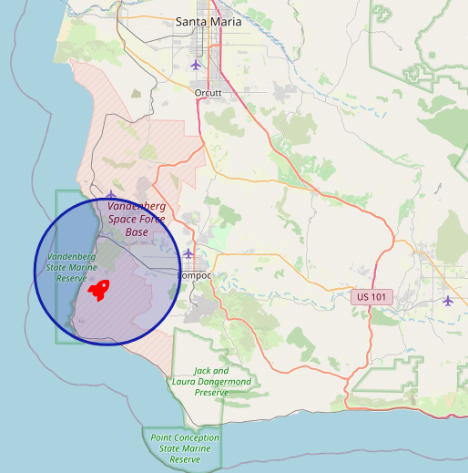
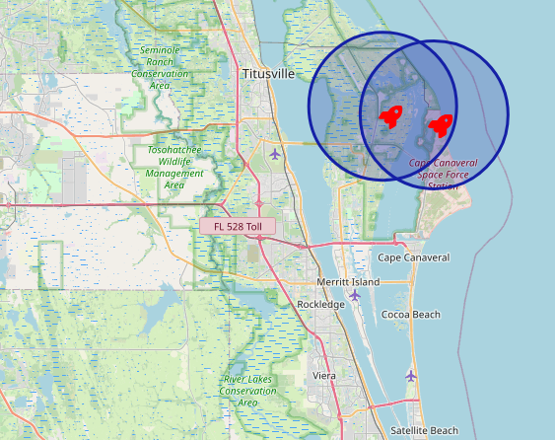
Map of Space-X Launch Sites
Left is a map of the VAFB SLC-4E launch site in Vandenberg Space Force Base
Right is a map of the CCAFS LC-40, CCAFS SLC-40, and KSC LC-39A launch sites in Cape Canaveral Space Force Station and Kennedy Space Center
35

Slide 36
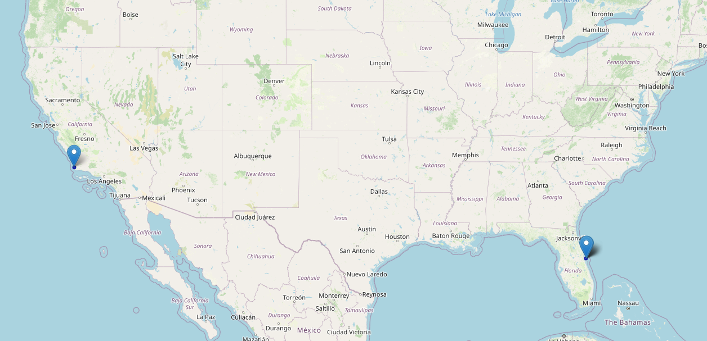
Map 2
Marker locations for California and Florida launch sites
36

Slide 37
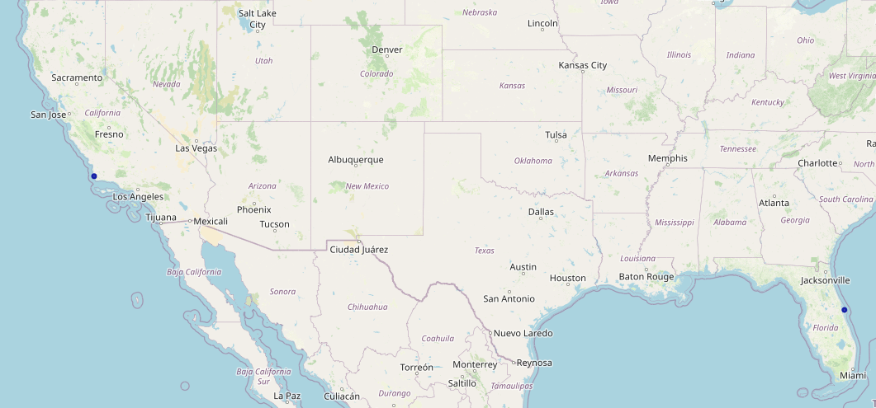
Map 3
37

Slide 38

Section 4

Slide 39
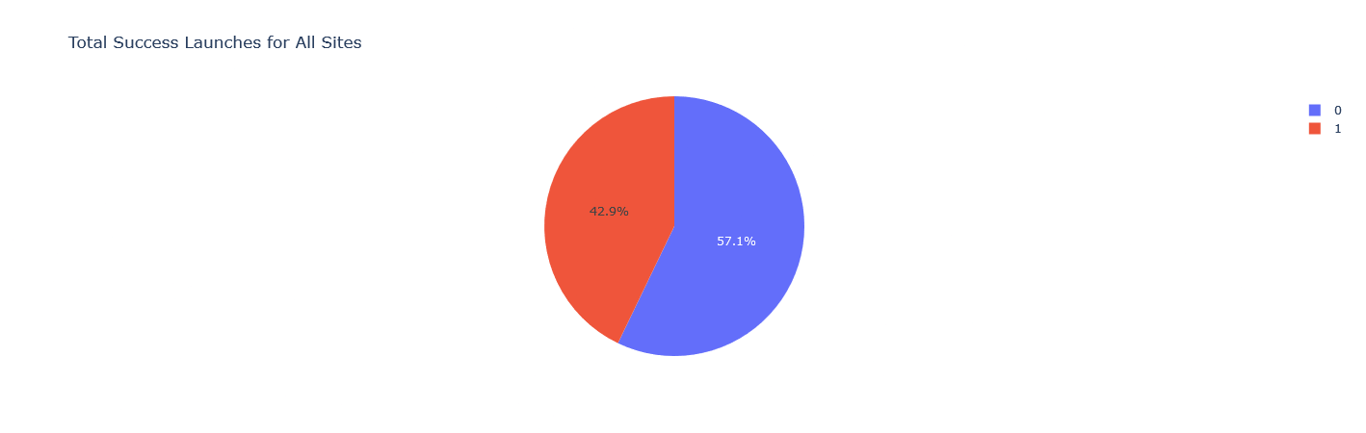
Overall Successful Landing Rate
The above pie chart shows the landing rate of stage 1 rockets for all launch sites.
Roughly 43% of all Falcon 9 rockets landed successfully.
39

Slide 40
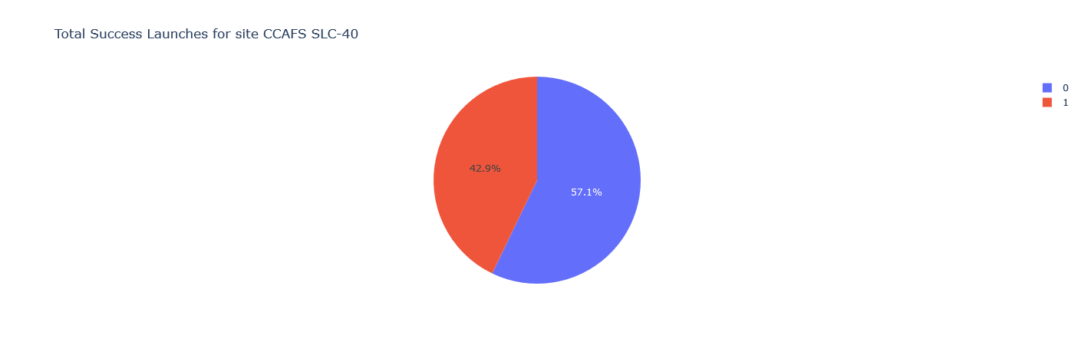
Highest Successful Landings
Pie chart for the success rate of all rockets launching from the Cape Canaveral ‘Slick 40’ SLC-40 launch site.
This site produces the highest rate of successful landings.
40

Slide 41
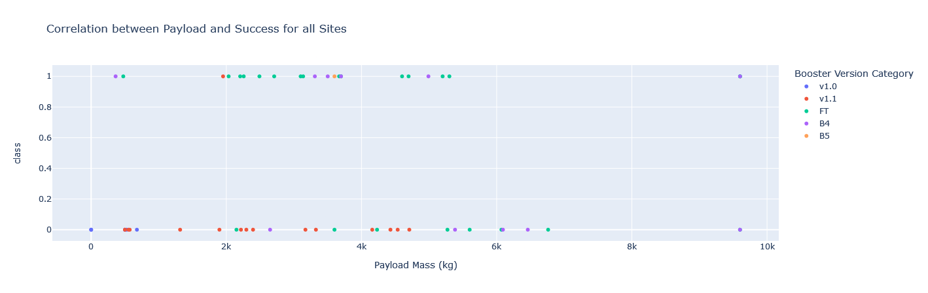
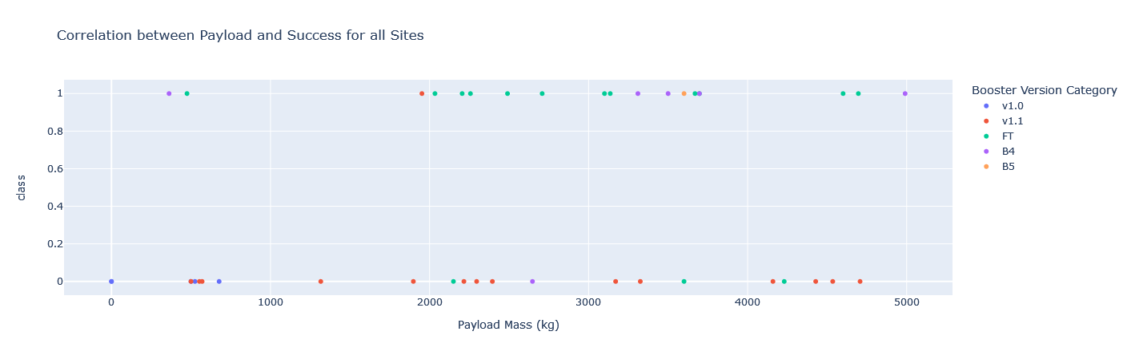
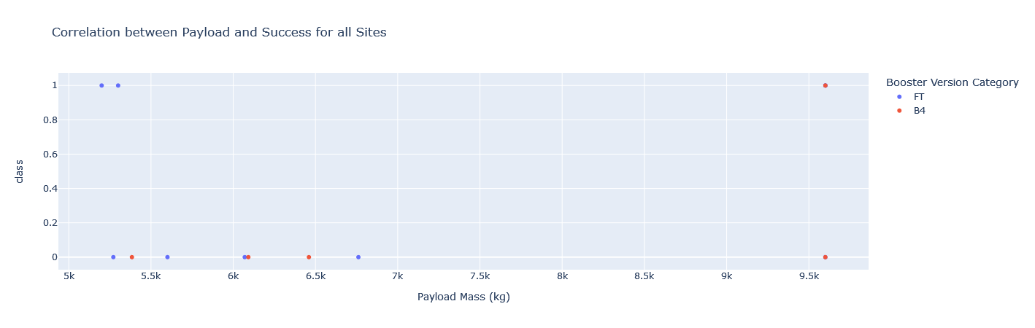
Launch Outcome vs Payload Mass
1.1
1.2
‘Class’ outcomes of launches differentiated by booster version:
Plot 1.1: The entire range of payload masses
Five unique booster for payloads ranging from 0 to 10000 KG
Plot 1.2: ‘Payload Mass’ range from 0 to 5000 KG
Booster v1.0 used for very light loads
Booster v1.1 used for loads between 500 and 5000 KG
Plot 2.1: ‘Payload Mass’ range from 5000 to 10000 KG
Only two boosters used for mid to heavy loads
B4 is the only booster used above 7000 KG
2.1
41

Slide 42

Section 5

Slide 43
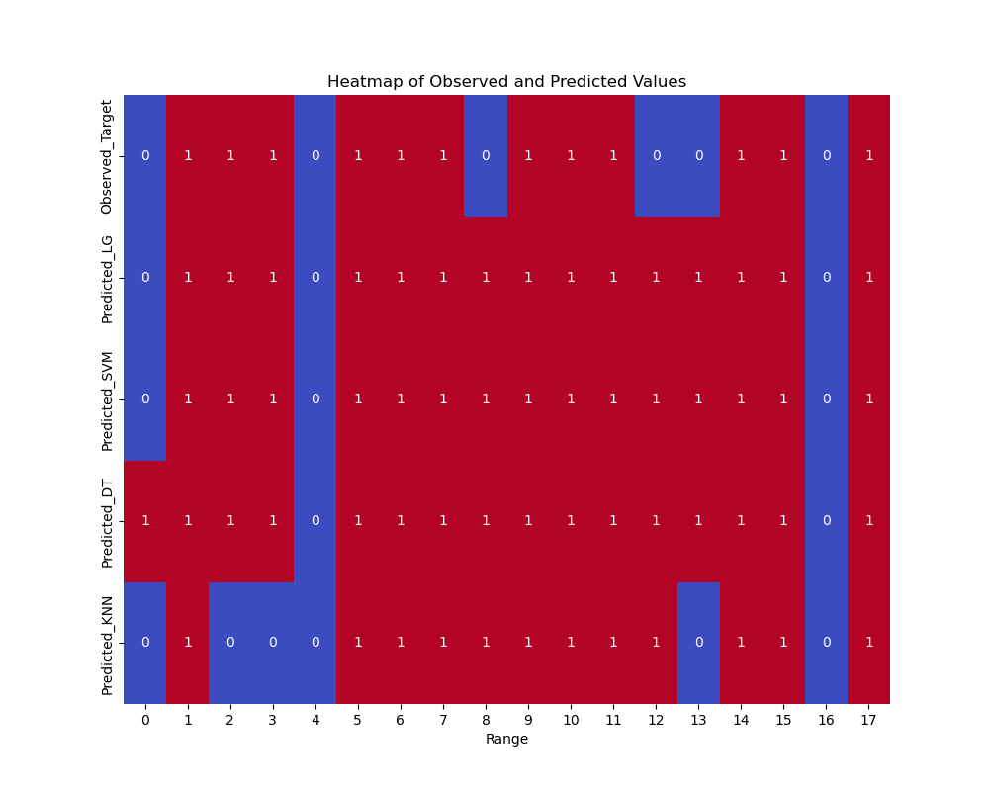
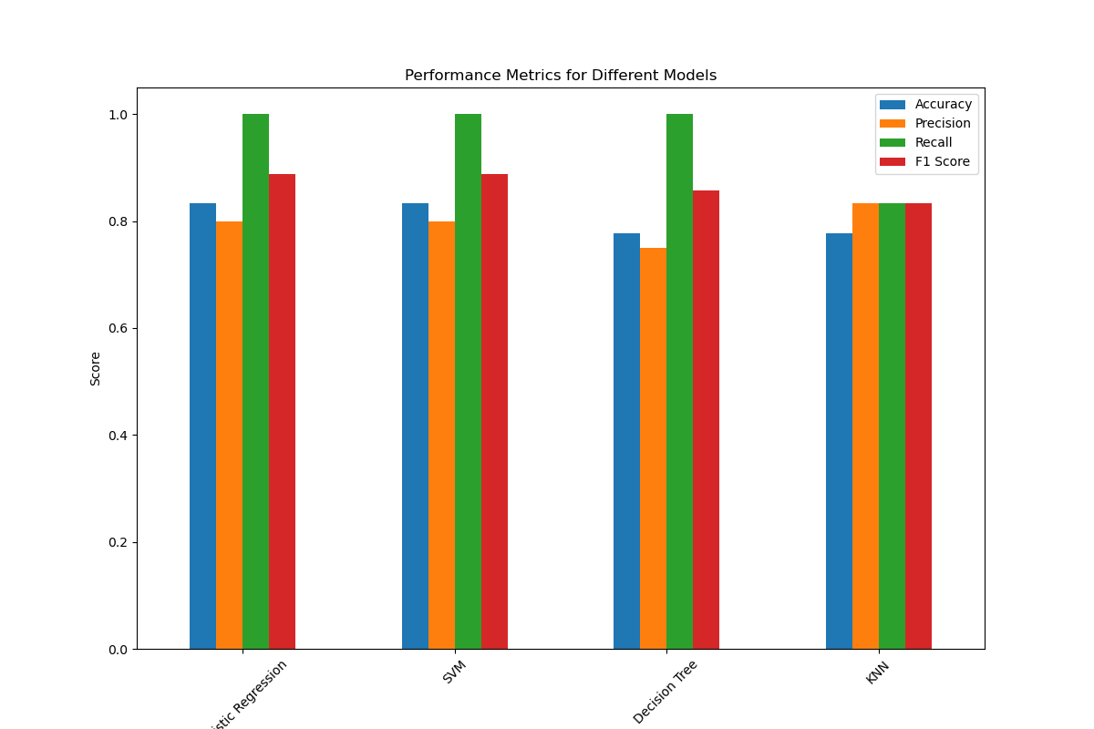
Classification Accuracy
On the top left is a Heat map showing the observed and predicted values for the set of testing data used to evaluate each model
The testing set contained a total of 18 records
On the top right is a bar chart displaying the metrics Accuracy, Precision, Recall, and F1 Score for each model
Logistic Regression, SVM, and Decision Tree produce perfect Recall and has high values for all other metrics
43

Slide 44
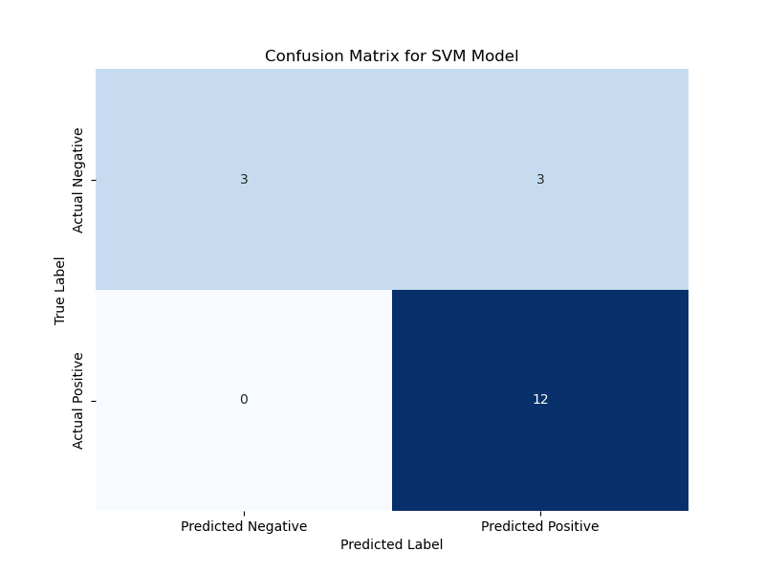
Confusion Matrix
Support Vector Machine Confusion Matrix
Support Vector Classifier chosen as best predictive model
Best Parameters:
'C': 1.0, 'degree': 1, 'gamma': 0.03162277660168379, 'kernel': 'sigmoid‘
Classifier Metrics:
F-1 Test Score: 0.8889
Accuracy Test Score: 0.8333
ROC-AUC Score: 0.7500
Summary
Excellent at predicting negative classes when detected
Fails to detect half of all negative classes
Predicts 80% of all positive classes: 3 False Positives
Has perfect recall for positive class: 0 False Negatives
Overall the model performs quite well at identifying positive cases but is not so good at detecting negative cases
44

Slide 45
Conclusions
Successful rocket landings increased as Space-X gained more experience.
Launches occurred most frequently at Cape Canaveral Air Force Station with rockets launched from site SLC “Slick” 40 having the highest rate of successful landings.
Booster v1.1 has the overall lowest success rate
The Decision Tree Classifier always performs the best in training but the worst in testing which suggests that the model is overfitting the training data.
All models produce identical confusion matrices save KNN which has a 78% accuracy and does a better job at detecting and predicting its positive classes.
Results for Logistic Regression were very similar to SVM in both training and testing but was ultimately disqualified for having a lower ROC-AUC score.
45

Slide 46
Appendix
All support data for this presentation can be found at the following link:
https://github.com/Dichotmy/IBM-Data-Science-Professional/tree/main/10.%20Applied%20Data%20Science%20Capstone/Labs
46
Notes:
46

Slide 47


